Slide 1
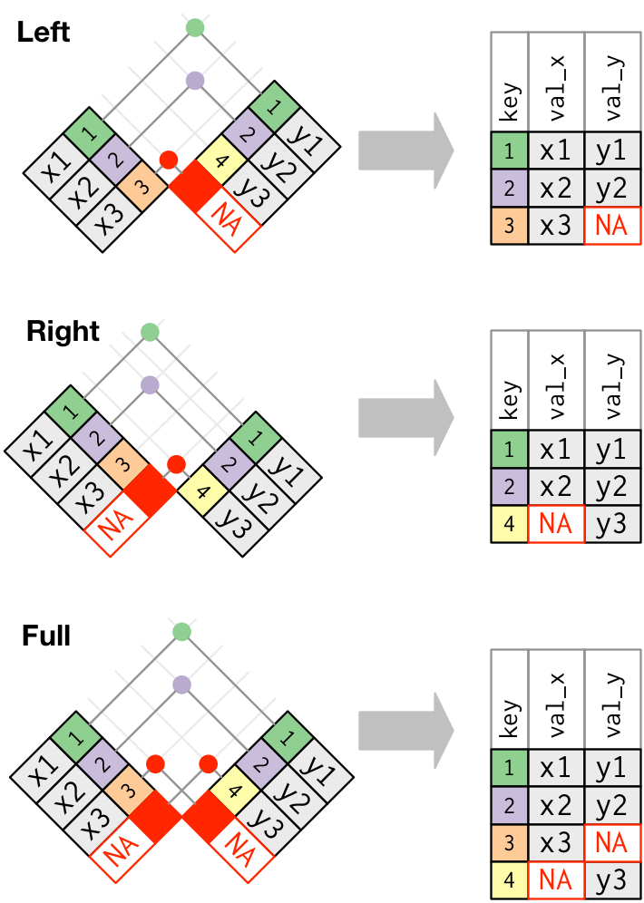
Lesson 20: Relational data I: Keys and Joins
SE370 – Computer-Aided Systems Engineering
MAJ Jae Kim DSE- Instructor

Slide 2
Today
Lesson 20: Relational data I: Keys and Joins
  1. Identify the keys in a dataset
  2. Join two datasets together using a unique identifier (key)
  3. Understand and apply mutating and filtering joins
2

Slide 3
Next Time
Lesson 21: Relational data II
  1. Understand the advantages and disadvantages of a relational database
  2. Create and query a relational database to answer simple questions
3

